Slide 1
CS230: Deep Learning
Section 1
Notes:
Welcome to section 1! Hope first week's been going well. Today's going to be all about the project.

Slide 2
Agenda
Introductions
Project Logistics
Project Tips
Literature Review Example
Example Proposal
Notes:
Brief agenda: start off with intros, then talk about project logistics/tips. We'll go through some brainstorming activities in small groups, come back as a larger class to brainstorm/share ideas, and then go through an example proposal from a previous student.

Slide 3
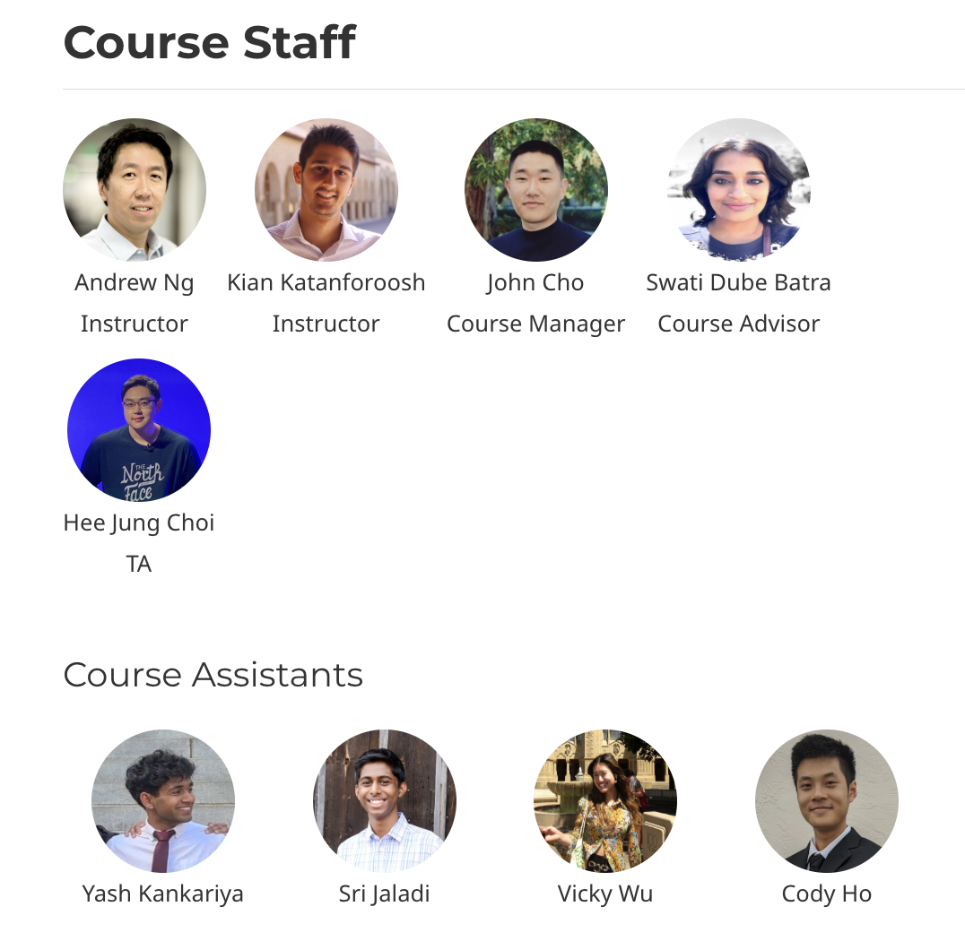
Agenda
Introductions
Project Logistics
Project Tips
Literature Review Example
Example Proposal
Notes:
This is us

Slide 4
Goals for today:
Know the main project components + deadlines
Generate new project ideas
Recognize good/feasible projects
Notes:
Purpose of section 1: give overview of logistics + brainstorming project ideas

Slide 5
Agenda
Introductions
Project Logistics
Project Tips
Literature Review Example
Example Proposal
Notes:
let's talk about project logistics

Slide 6
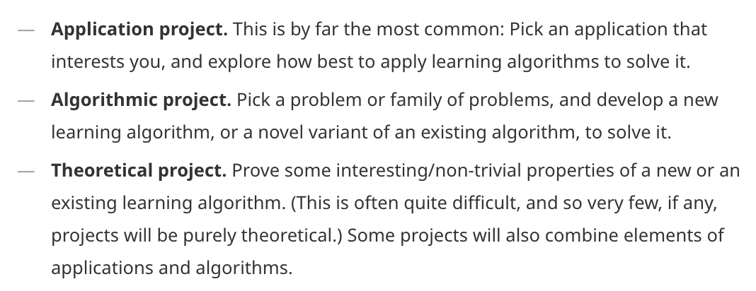
Types of CS230 projects
Notes:
Wanted to start off with some example projects. Might be wondering, what constitutes a final project for this class?
Essentially anything using deep learning, could be for any application or any concept mentioned in course or not in course, totally open to you, world's your oyster.
We've had some really novel projects in the past, like this team which tried to identify people based on how they typed, using a concept called triplet loss and hard negative mining, both of which we'll talk about later on in the class

Slide 7
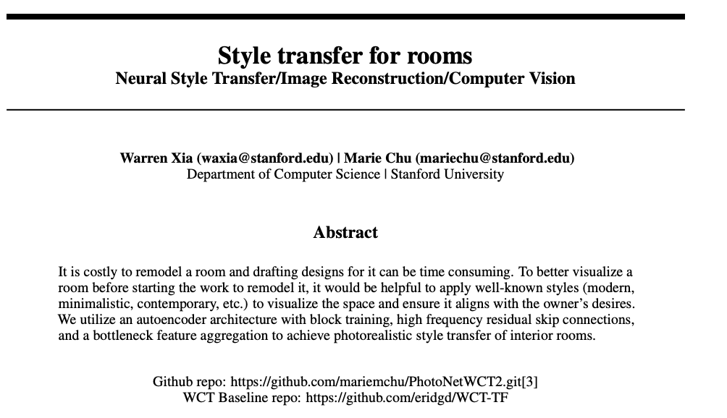
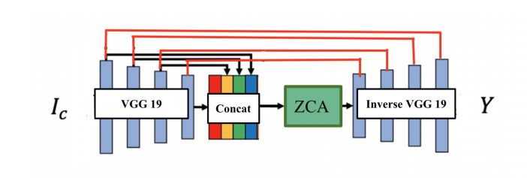
What does a CS230 project look like?
Notes:
Wanted to start off with some example projects. Might be wondering, what constitutes a final project for this class?
Essentially anything using deep learning, could be for any application or any concept mentioned in course or not in course, totally open to you, world's your oyster.
We've had some really novel projects in the past, like this team which tried to identify people based on how they typed, using a concept called triplet loss and hard negative mining, both of which we'll talk about later on in the class

Slide 8
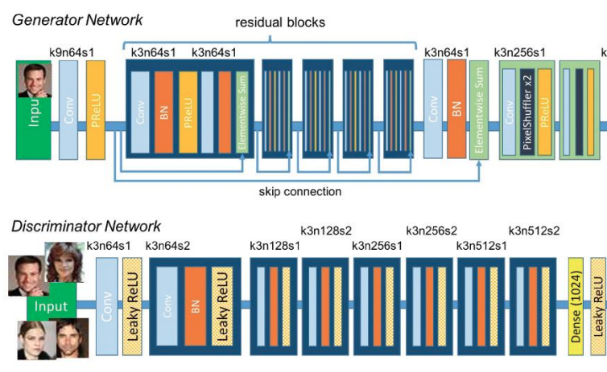
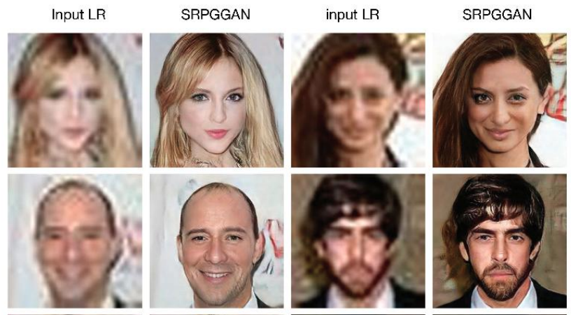
What does a CS230 project look like?
Notes:
Also this team who did image super resolution using this concept of GANs, which will be covered in a later lecture.

Slide 9
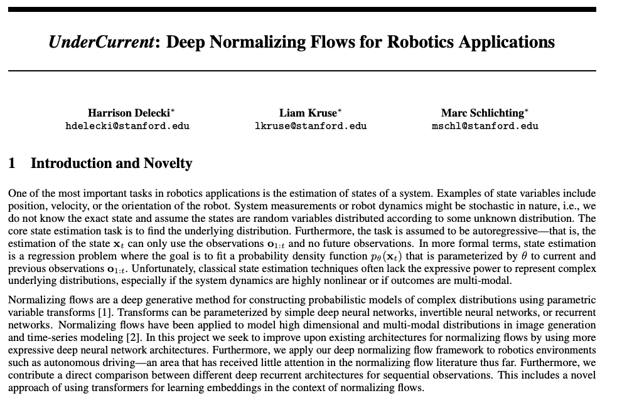
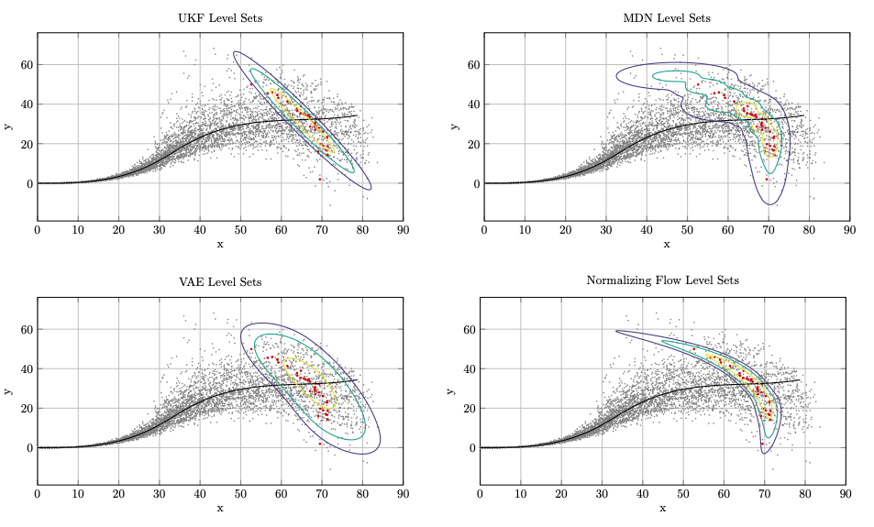
What does a CS230 project look like?
Notes:
and this team which did a little bit of application and a new architecture/ “algorithm”.

Slide 10
Deliverables
Proposal Tue, 10/14 (11:00 AM)
Milestone Tue, 11/11 (11:00 AM)
Final Report Fri, 12/05 (11:59 PM) (no late days)
Final Poster Session Wed, 12/10 (12:15 PM – 3:15 PM) (no late days)
Sometime before the proposal and milestone deadlines you're required to meet with a TA for 15 minutes with your group. Before the proposal, this will be with any TA (sign up on Calendly). After, we'll assign your TA project mentor who you will meet with consistently.
There are two project meetings required.
The final poster session is required in-person for non-CGOE/SCPD students
All times are in Pacific Time (California)
Notes:
4 main deliverables, spread out throughout the quarter. Before each deliverable have to meet with a TA to discuss (3 meetings required).
The reason for the meetings is to help you incorporate feedback into your work
your first meeting before the proposal will be with a random TA, after that you'll be assigned a project mentor who you'll meet with for the rest of the quarter.
FIRST DEADLINE IS COMING UP QUICKLY - top priority should be finding a project idea & teammates asap! Luckily, we hope to help you with this section..

Slide 11
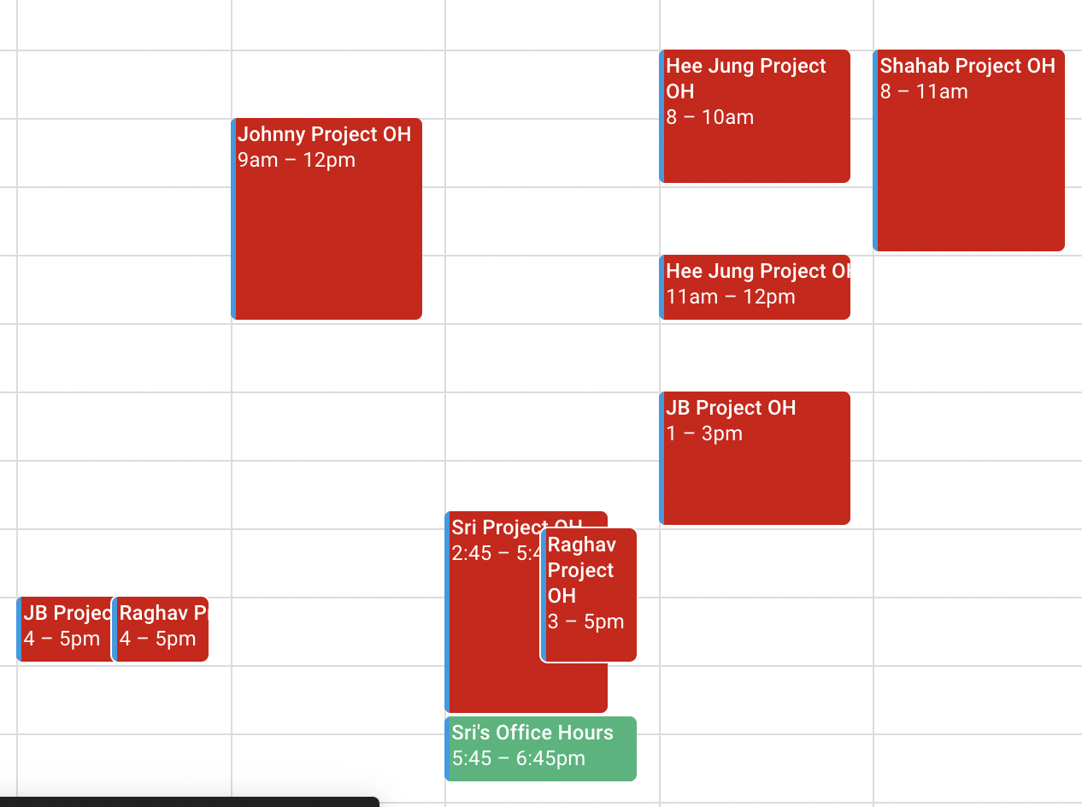
On Meeting with TAs
Weekly view of the course calendar:
There's two kinds of OH: General and Project OH (for project guidance/feedback)
NOTE THAT THIS IS
LAST YEAR’S SCHEDULE
PLEASE VIEW WEBSITE ONCE
UPDATED TO GET THIS YEAR’S
Notes:
a quick aside on scheduling those project meetings. if you go to the "OH" page on the website, and scroll down a bit you'll see this google calendar. shows our OH times.

Slide 12
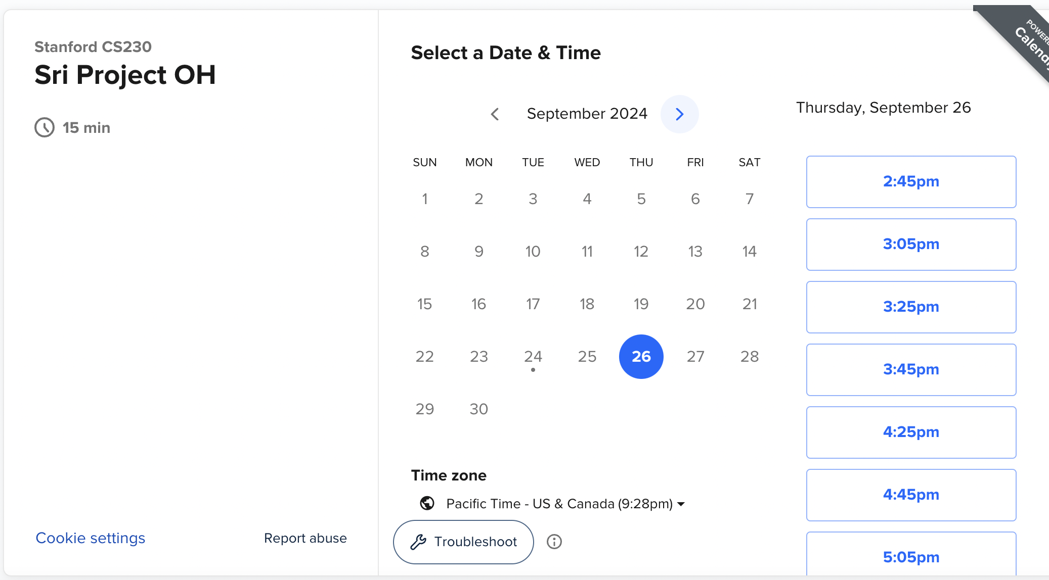
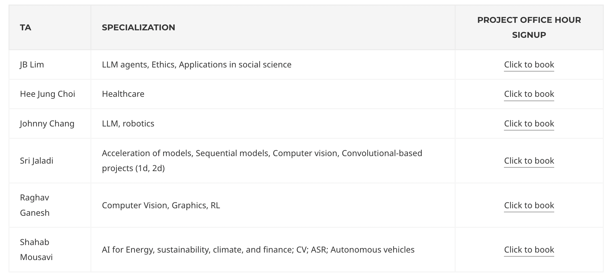
On Meeting with TAs
To schedule a meeting, use the calendar to see when TAs have OH, identify which TA you want to meet with, and then click the "Click to book" link. If you can’t find a slot, post on Ed!
THIS IS
LAST YEAR’S PAGE
PLEASE VIEW WEBSITE ONCE
UPDATED TO GET THIS YEAR’S
Notes:
to schedule a meeting, find the TA you want to meet with, then go to the top and click the "click to book" link - it'll take you to another link where you enter the day/time.
Using Calendly for OH this quarter. Definitely recommend you check it out beforehand!
if you can't make the meeting times post on Ed and we'll work something out.

Slide 13
Agenda
Introductions
Project Logistics
Project Tips
Literature Review Example
Example Proposal
Notes:
Tips: 1) what makes a good project? 2) Coming up with an idea, and what comes after

Slide 14
What makes a good project?
In descending order of importance:
“Technical Quality”
Novelty / Trying out new ideas
Significance
Going through all the project steps, being able to "pivot"
Having multiple experiments / results (qualitative and quantitative)
Good results (nice to have but not necessary)
Not enough to “git clone” models and tune hyperparams. You cannot just finetune an existing model on a dataset. Have to add your own touch! These are research projects.
Notes:
what makes a good project? in descending order of importance: technical quality, novelty (trying out new ideas), significance (application to real world), being able to pivot (how you handle difficulties through the course of the project, do you try out a bunch of stuff or get stuck and stay stuck), multiple experiments (how much were you able to try out), and good results (least important, helps but does not hurt if you don't have good results)
types of projects? application (apply existing model to new task), algorithm (come up with new model), and theory (come up with new theory/proof/small example). all have some aspect of novelty
should be research projects, with emphasis on research!

Slide 15
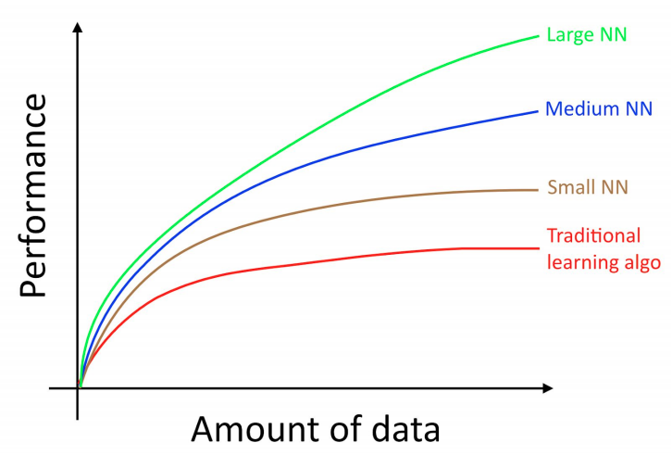
What makes a good project?
Remember this is a deep learning class! Focus on the deep learning and not on data collection, pre-processing, scraping, etc.
The more data the better!
Also be wary of computational feasibility.
Limited number of computational credits
The more complex, the longer models take to train, the fewer experiments can run
The longer it takes to see if you need to change course
Notes:
eg: train a skin lesion classifier off of 500 images? doable but very challenging with DL!
also be wary of computational feasibility: we give $500 credits on AWS, on the machines we suggest each hour of compute is roughly $1.
good for most projects but not if you want to train hundreds of models!

Slide 16
Coming up with Ideas?
Project Categories
Computer Vision
Natural Language Processing
Generative Modeling
Speech Recognition
Reinforcement Learning
Learning Healthcare
Look at past projects:
http://cs230.stanford.edu/past-projects/
Also check out other class projects: (CS229, CS229A, CS221, CS224N, CS224U, CS231N, CS234).
Want to do something more research oriented? Look at Google Scholar, Arxiv, and top DL conferences like NeurIPS, ICML, ICLR, CVPR, ECCV/ICCV, AAAI, CoRL, etc.
Notes:
coming up with ideas: maybe the hardest part of the next week (TAs can help you with most of the stuff in the class except for the idea)
these are the categories, highly recommend you start out with looking at project site. Thousands of good project ideas there! with starting points documented so you know what worked/didn't. can contact past students asking for their code!
also other class projects, people's posts online, professional research papers, etc.

Slide 17
Scoping out an idea
Often students get excited and take on more than they can handle in one quarter
Your project mentors can help you scope out an idea to make it viable for the course requirements and scope
Suggestion: have a base goal that you can certainly achieve in the quarter and a stretch goal that you hope to achieve but your project will still be solid without it.

Slide 18
What comes after finding the idea?
Literature review:
Awesome NLP, Awesome GAN, Awesome DL
Arxiv
Google Scholar, Google Search
Github
Arixv-sanity.com
Paperswithcode.com
Medium articles and other blogs
Other Stanford courses!
Look for baselines & starter code you can run & ideas for next steps
Notes:
after the idea, do a literature review. see what's done already, what you can add to the field. there's all these awesome pages on github that compile list of resources/papers, there's arxiv which have non peer-reviewed papers, google pages, github code, arxiv sanity which shows new papers from arxiv, and paperswithcode (which is named appropriately)

Slide 19
What comes after finding the idea?
Option 1: Build one yourself
Web scraping
Synthetic/simulated data
Collect it yourself?
Dataset: Data is one of the biggest things to making sure your DL project will be successful! Spend time doing your due diligence here.
Option 2: Use pre-existing datasets
Google Dataset Search
Kaggle
Stanford Research groups
Online datasets/benchmarks. Your literature review should help with this.
Notes:
after the idea, dataset! remember dataset is one of the most important things
you can build one yourself (kian did this for the "Activate" programming assignment - walked around campus at night several times collecting recordings of people saying stuff)
alternatively can use pre-existing dataset from online

Slide 20
More data questions
How much data do you need?
How diversified/balanced is the data?
What if there isn't enough data?
How clean is the data?
Dataset licensing?
Notes:
all these questions you should consider

Slide 21
Data Compliance
Most data is public -> can be found online and/or anyone can access it.
For a variety of reasons, some data you need for your project might be private. This is acceptable to use but please remember the following:
  Any contracts, agreements, and/or compliance are YOUR responsibility
  You must provide enough information/results to be graded and to display that you completed your project.
We encourage you to use public data as much as possible.

Slide 22
Policy on external mentorship/collaboration
It is okay to seek external mentorship collaboration for your project but keep the following in mind:
  The external collaborators cannot make significant contributions to the project, i.e., writing code, making the report/video, contributing key research directions and ideas.
  In addition to the report and video, you will need to submit your final code to the CAs or make your Github repository public for grading purposes. CAs may also want to run your code.
  Keep in mind that CAs can do their best to help you with your project during OH when you’re giving them all the relevant information. This is easiest when your work is not behind an NDA or other agreement.

Slide 23
Agenda
Introductions
Project Logistics
Project Tips
Literature Review Example
Example Proposal
Notes:
let's go through a quick example of a lit review search together

Slide 24
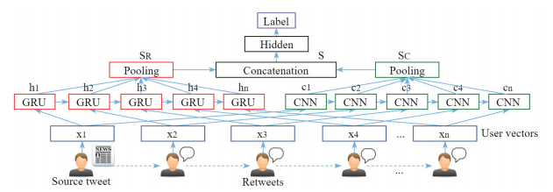
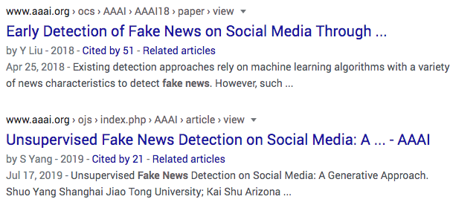
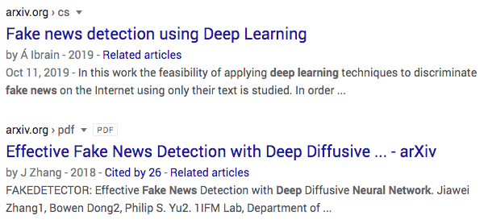
Lit Review
Fake news detection
  google/semantic scholar: "fake news deep learning"
  "site:" search - arxiv, github, stanford
  search conferences, neurips, cvpr, etc.
  Check out CS224N projects
Notes:
let's say we're doing fake news detection.

Slide 25
Agenda
Introductions
Project Logistics
Project Tips
Literature Review Example
Example Proposal
Notes:
now let's go through an example proposal

Slide 26
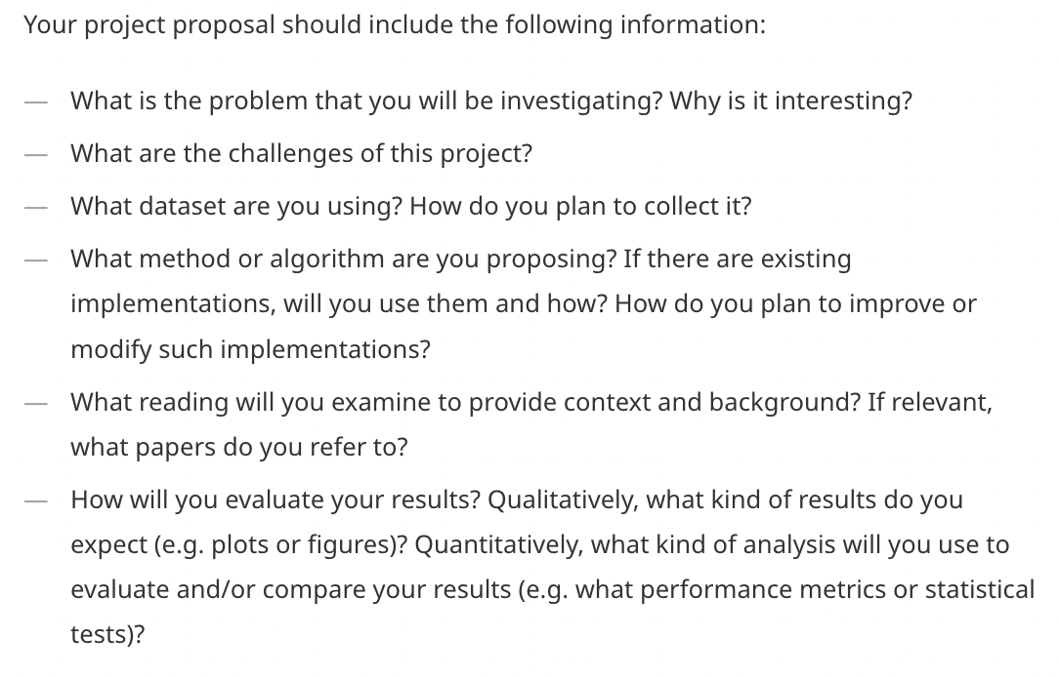
Proposal Requirements: 300-500 words
Notes:
quick set of requirements. note only 300-500 words, so should be short - looking for brevity
should answer these questions, we'll see mohamed answers all those questions in his proposal

Slide 27
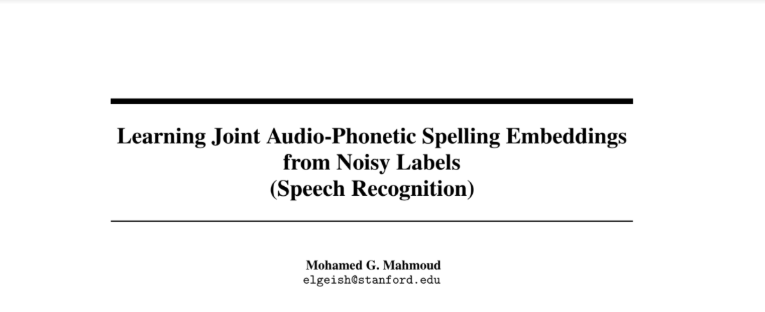
Notes:
this is from a former TA, mohamed, so it's exceptional - don't expect all proposals to be this polished/professional but a great example
Still a good ideal to strive for

Slide 28
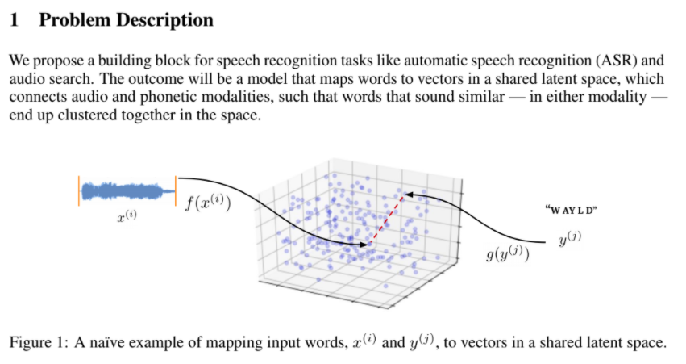
What is the problem you are investigating? Why is it interesting?

Slide 29
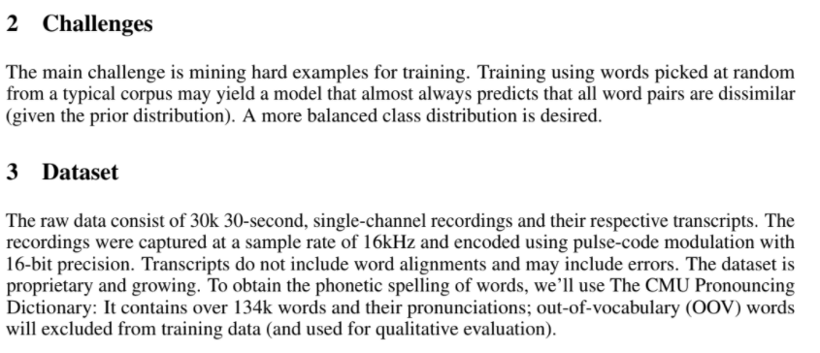
What are the challenges of this project?

Slide 30
What dataset are you using? How do you plan on collecting it?
Notes:
Notice how precisely he specified the parameters of data collection

Slide 31
What dataset are you using? How do you plan on collecting it?
Notice how precisely he specified the parameters of data collection
Notes:
Notice how precisely he specified the parameters of data collection. Very useful if your dataset is used in the future.

Slide 32
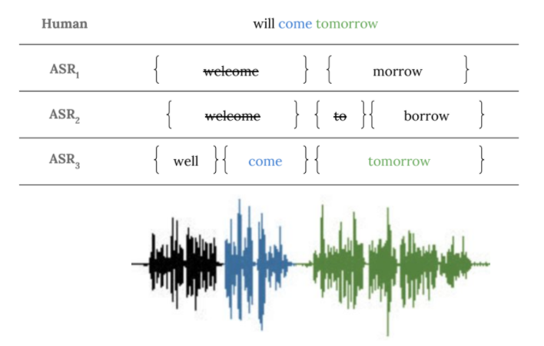
What dataset are you using? How do you plan on collecting it?

Slide 33
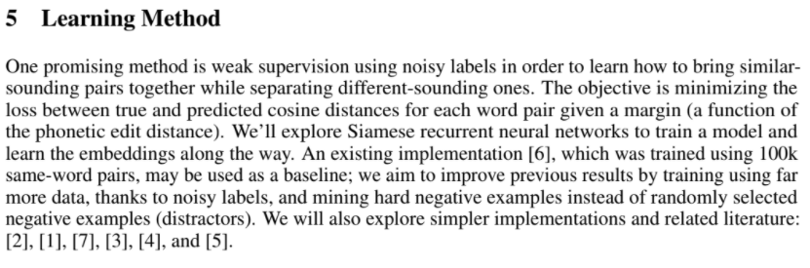
What method or algorithm are you proposing?
Notes:
Be specific here! Not sufficient to just say CNN - we want to see you've done some research eg into types of CNNs, layers, etc.

Slide 34
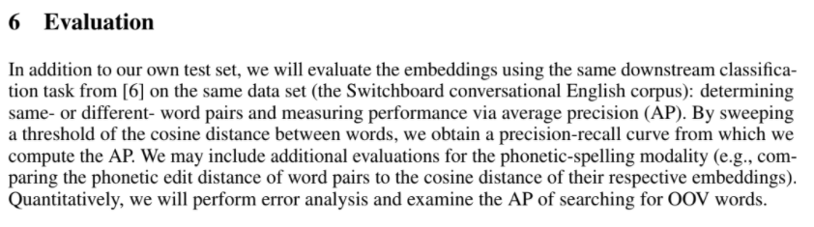
How will you evaluate your results?

Slide 35
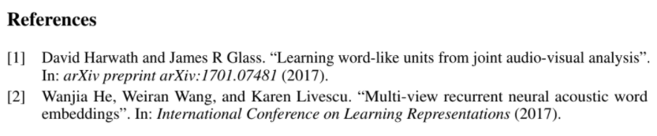
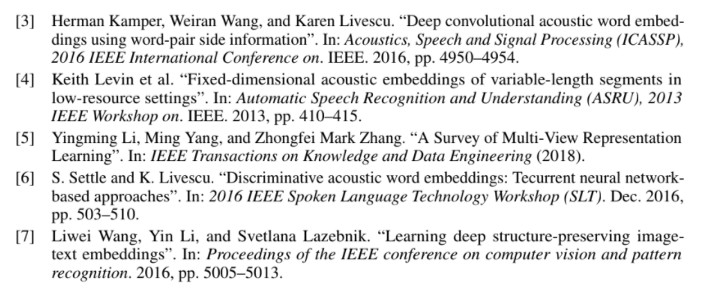
What reading will you examine to provide context/background?

Slide 36
Takeaways
Keep track of the deadlines. Proposal is coming up on 10/14!
Meet with TAs regularly about your project
Focus on the deep learning part of the project; don’t waste too much time on data collection, pre-processing, etc.
Do something new and exciting! Don’t worry too much about results
Have a base goal that you can definitely achieve in the quarter and a stretch goal.

